Slide 1
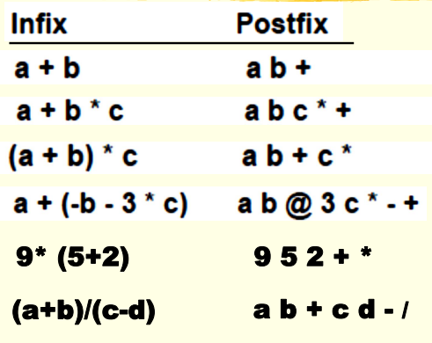
Compiler

Slide 2
Compiler
A+b * c >> a+bc* >> abc*+
(a+b) * c >> ab+ * c >> ab+c*
(a+b)/(c-d) >> ab+/(c-d) >> ab+/cd-
Ab+cd-/
A+(-b-3*c) >> a+(-b-3c)* >> a+(-b3c)*-
a(-b3c)*-+ >> ab@3c*-+

